Slide 1

SWAN K18X001.00 Button issue
JBD-VN-ME
1

Slide 2
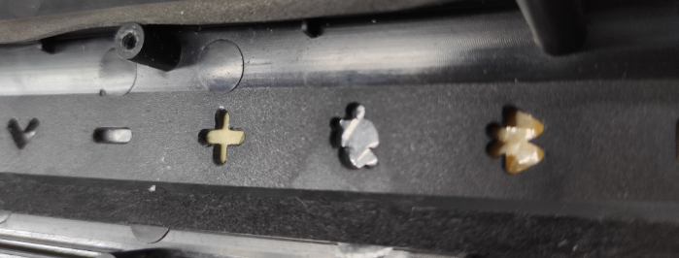
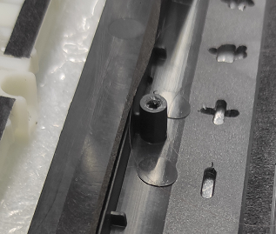
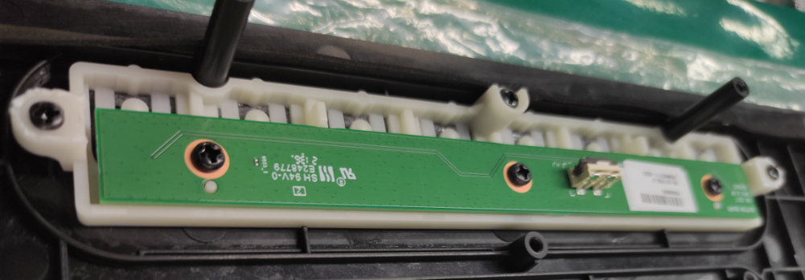
1. Abnormal height of Ejector mask
Gap:0.15~0.25 mm
Gap:0.15~0.25 mm
The height of the ejector mask is 0.15~0.25mm, so that the button can not all extend out of the housing.

Slide 3
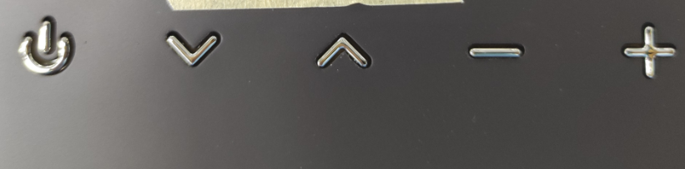
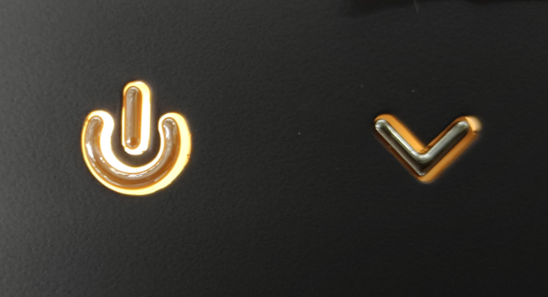
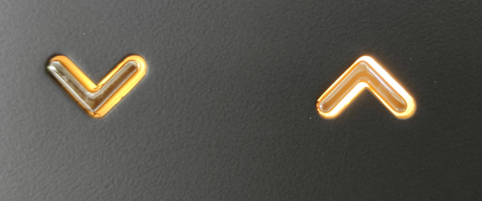
2. The button offset
The button is deflected to one side, which makes it easy to get stuck.

Slide 4
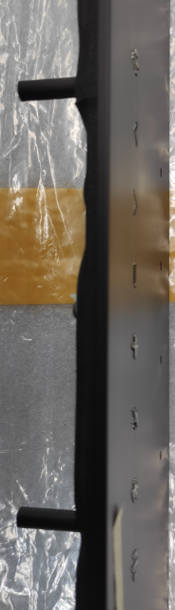
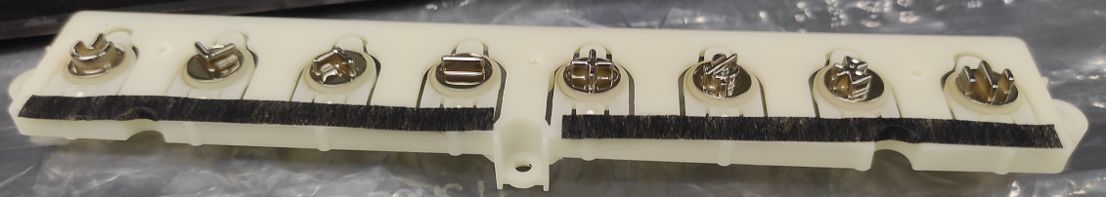
3. The button is deformed
來料按鈕凹陷
The button is deformed, and the height of the buttons is inconsistent after assembly.

Slide 5
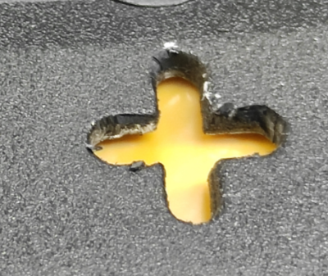
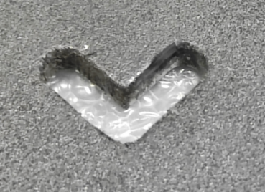
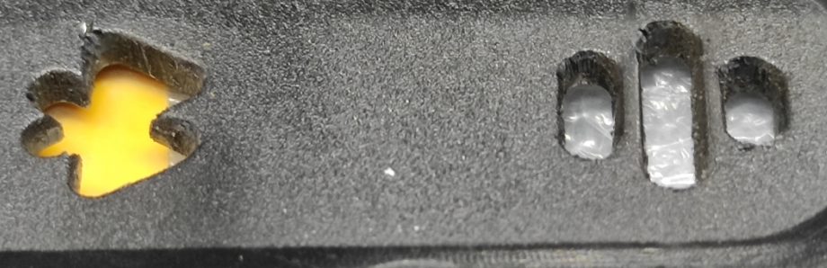
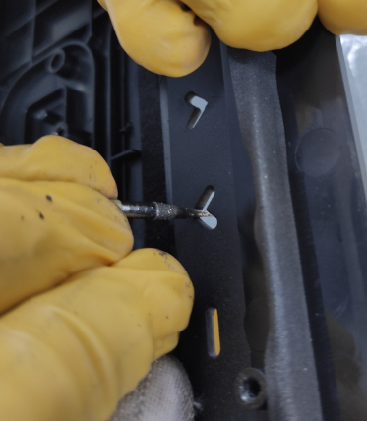
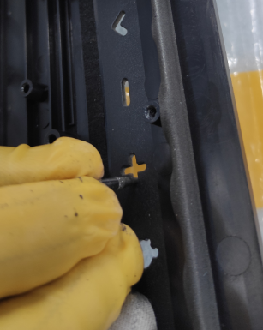
4. Vendor rework issue.
毛邊
毛邊
There are still burr after INKEL sorting
毛邊
毛邊
FII reworking

Slide 6
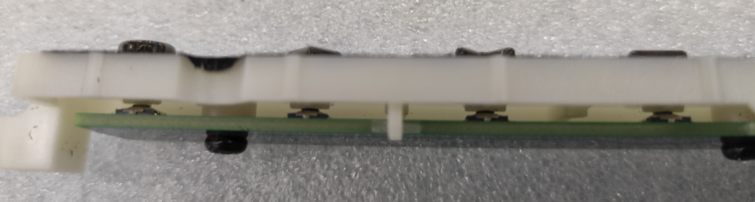
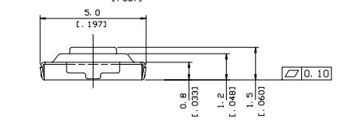
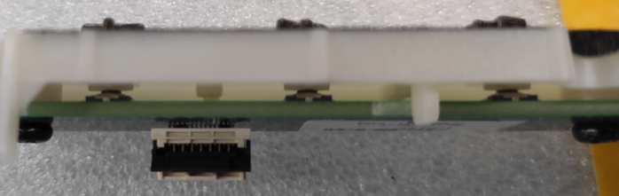
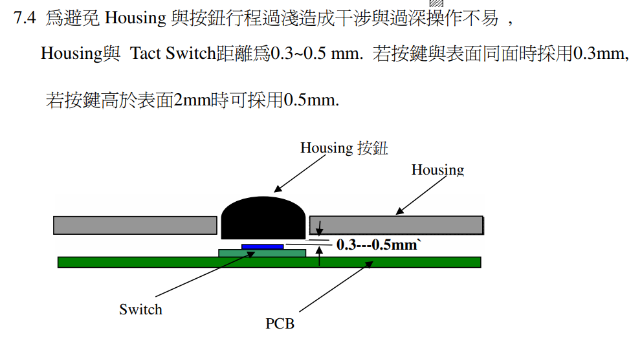
5. Design modify Suggest
Change the gap between Button and Key board to 0.3mm
No gap after Button &Key board assembly.
The touch of the button is not good due to the influence of pulling force.

Slide 7
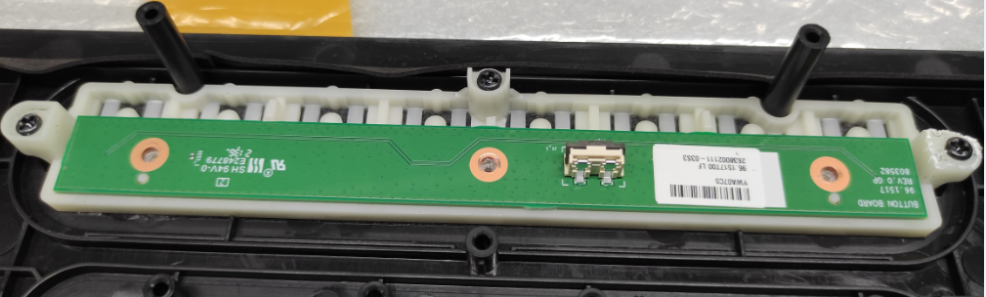
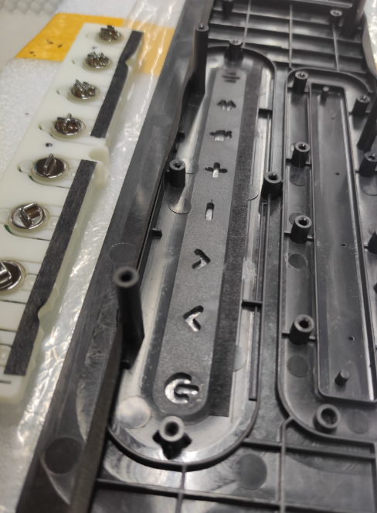
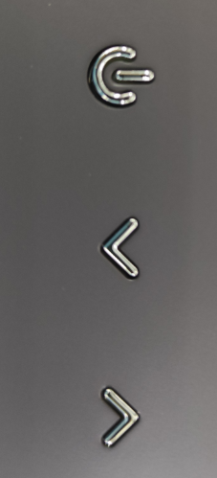
5. Design modify Suggest
No positioning pins on Button &Top cover
There are positioning pins on Key Board &Button
Shift
Shift
Increase chamfer
Shift
Shift
The button is deflected to one side after assembly.
Increase positioning pins and chamfer on top cover.

